Slide 1
project title:- Smart stick for blind people
Team members:-
20eg106124,
20eg106140,
20eg106150,
20eg106155

Slide 2
Aim of this project :-
The main aim of this project is to assist blind persons without any human need.
This smart stick aims at giving the blind person a better understanding of the path he is moving in.

Slide 3
MATERIALS REQUIRED FOR THIS PROJECT:-
1. Arduino UNO
2. HC-SR04 Ultrasonic Sensor
3. PVC Pipe.
4. Jumper Wires
5. DC Buzzer
6. Battery Connector:
7. 9V Battery (Rechargeable)
8. LED Diode
9. Cable Tie Clips:

Slide 4
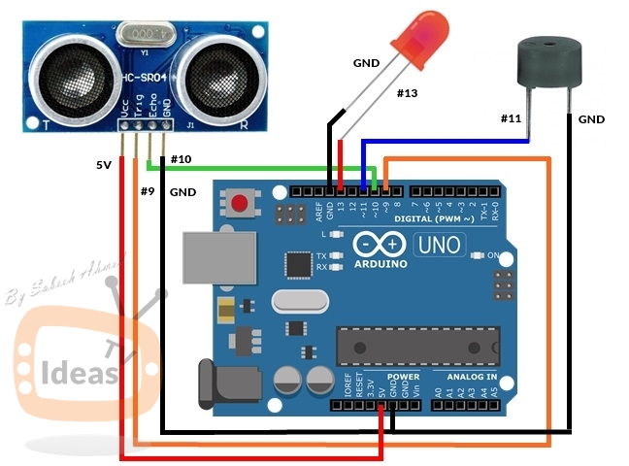
Circuit Diagram :-

Slide 5
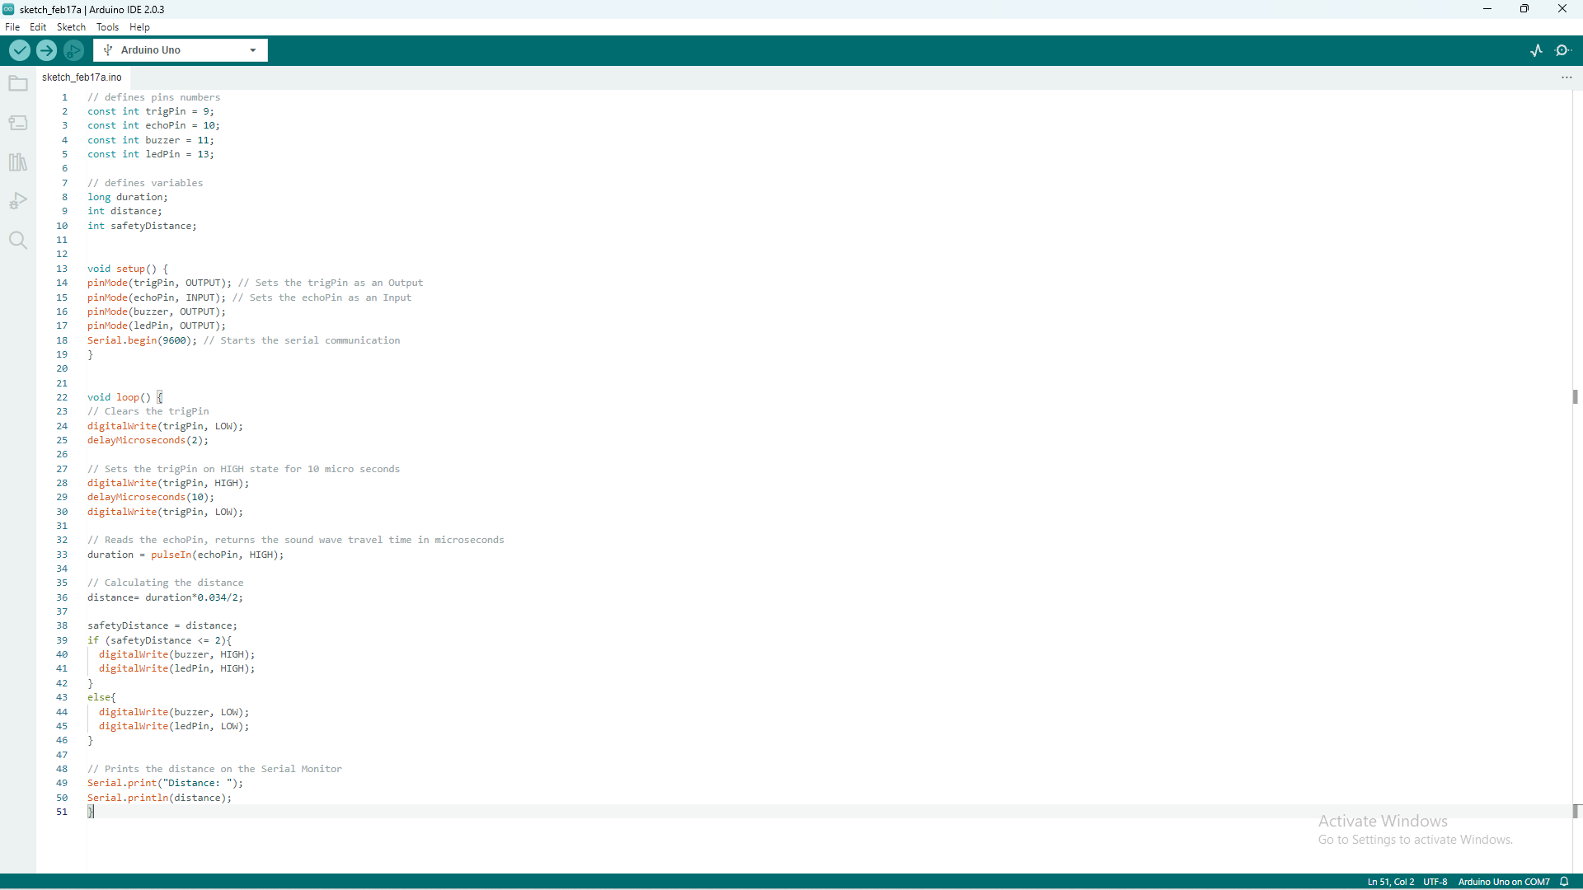
Project code :-

Slide 6
Main objective of the smart blind stick :-
To identify the solid objects and people within one-two meter range especially it can identify human beings separately from solid objects.
To identify the motion objects like vehicles which is coming towards the blind person.

Slide 7
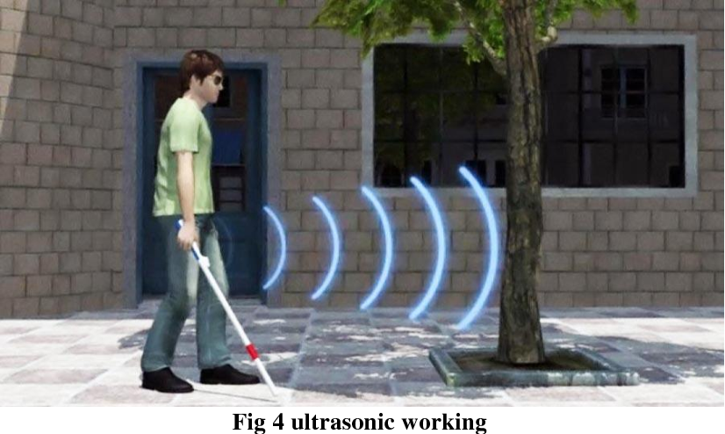
DEMONSTRATION OF SMART STICK

Slide 8
Thank you

